Slide 1
Automatic Fire Suppression System
Kilian Cox and Aashrith Beesabathuni

Slide 2
Design Visualization
9V Source
Fire Sensor 1
ESP32:
Reads and interprets flame sensor data, sends current to Motor controller and PWM signal to servo.
Motor
Fire Sensor 2
Infrared Activation
Voltage Divider
Fire Sensor 3
Servo
Fire Sensor 4
ESP32
Input Data:
4 Infrared flame sensors detect unwanted flame, delivering position to ESP32
Output Source:
Turntable Motor rotates to the correct burner position, trigger servo activates once target position is reached.

Slide 3
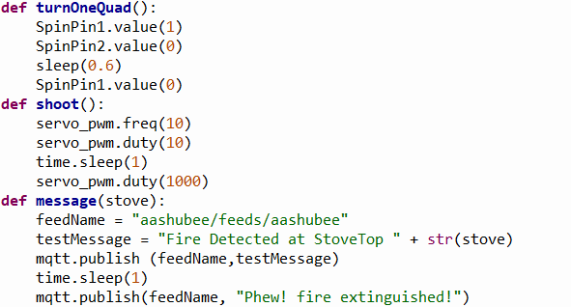
Computation: Results and Issues
All of our code was written in micropython, and uploaded through the Thonny software
Computationally: the system has 3 main functions that are called whenever needed through the program loop:
This allowed us to easily call functions later down the line, especially in a program that is very similar for each stovetop, with the distance being changed.
Some issues: PWM with the servo, as we had difficulties actuating it, and more importantly, getting it to stop actuating.

Slide 4
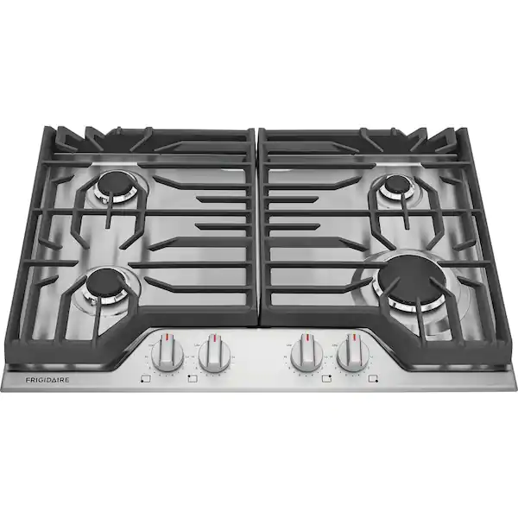
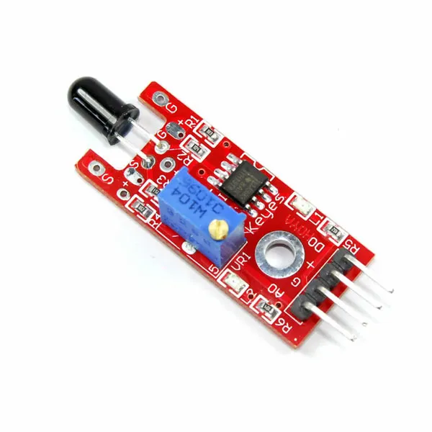
Sensing: Main Decisions & Results
Main Sensor: KY-026 Fire Sensor
This sensor works by detecting wavelengths found in fires, and outputting a HIGH or LOW signal based on whether the fire was detected
Sensor ha built in potentiometer, allowing us to turn the “sensitivity” on what constitutes high and what constitutes low
4 Sensors placed on 4 different stove burners, each connected to the pins of the ESP32

Slide 5

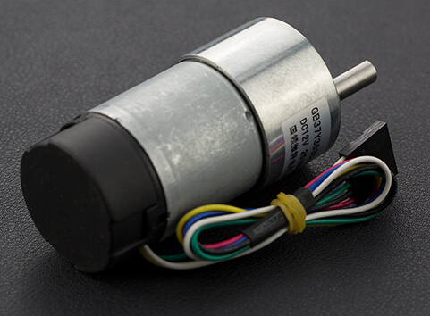
Actuation: Main Decisions
Trigger servos and turntable motor are main sources of actuation.
251 rpm motor from kit was deemed feasible enough to work with an 18:80 pulley reduction
The MS24 24KG servo was chosen given it’s high torque capabilities, while still being a relatively light servo option.
All design parts were waterjet and 3D printed to achieve the needed geometries.

Slide 6
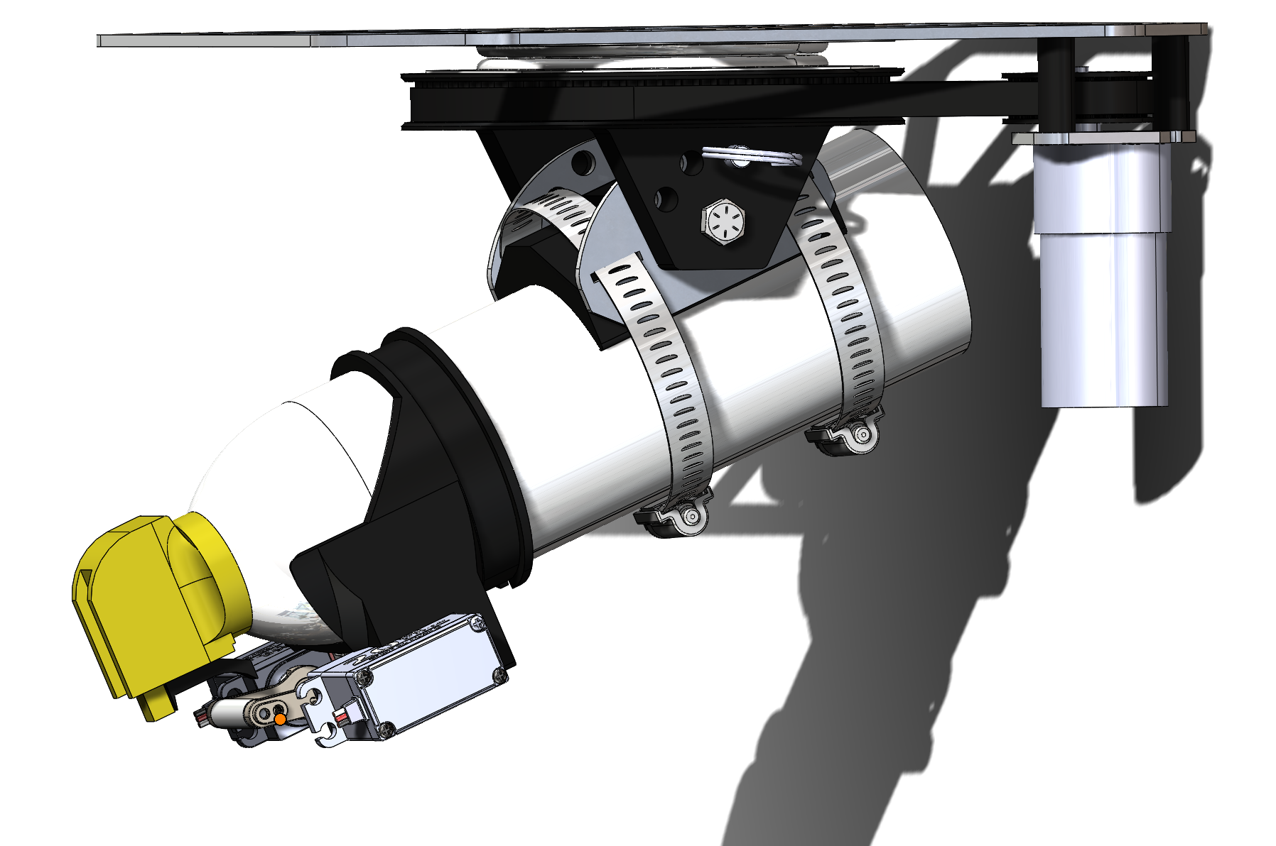
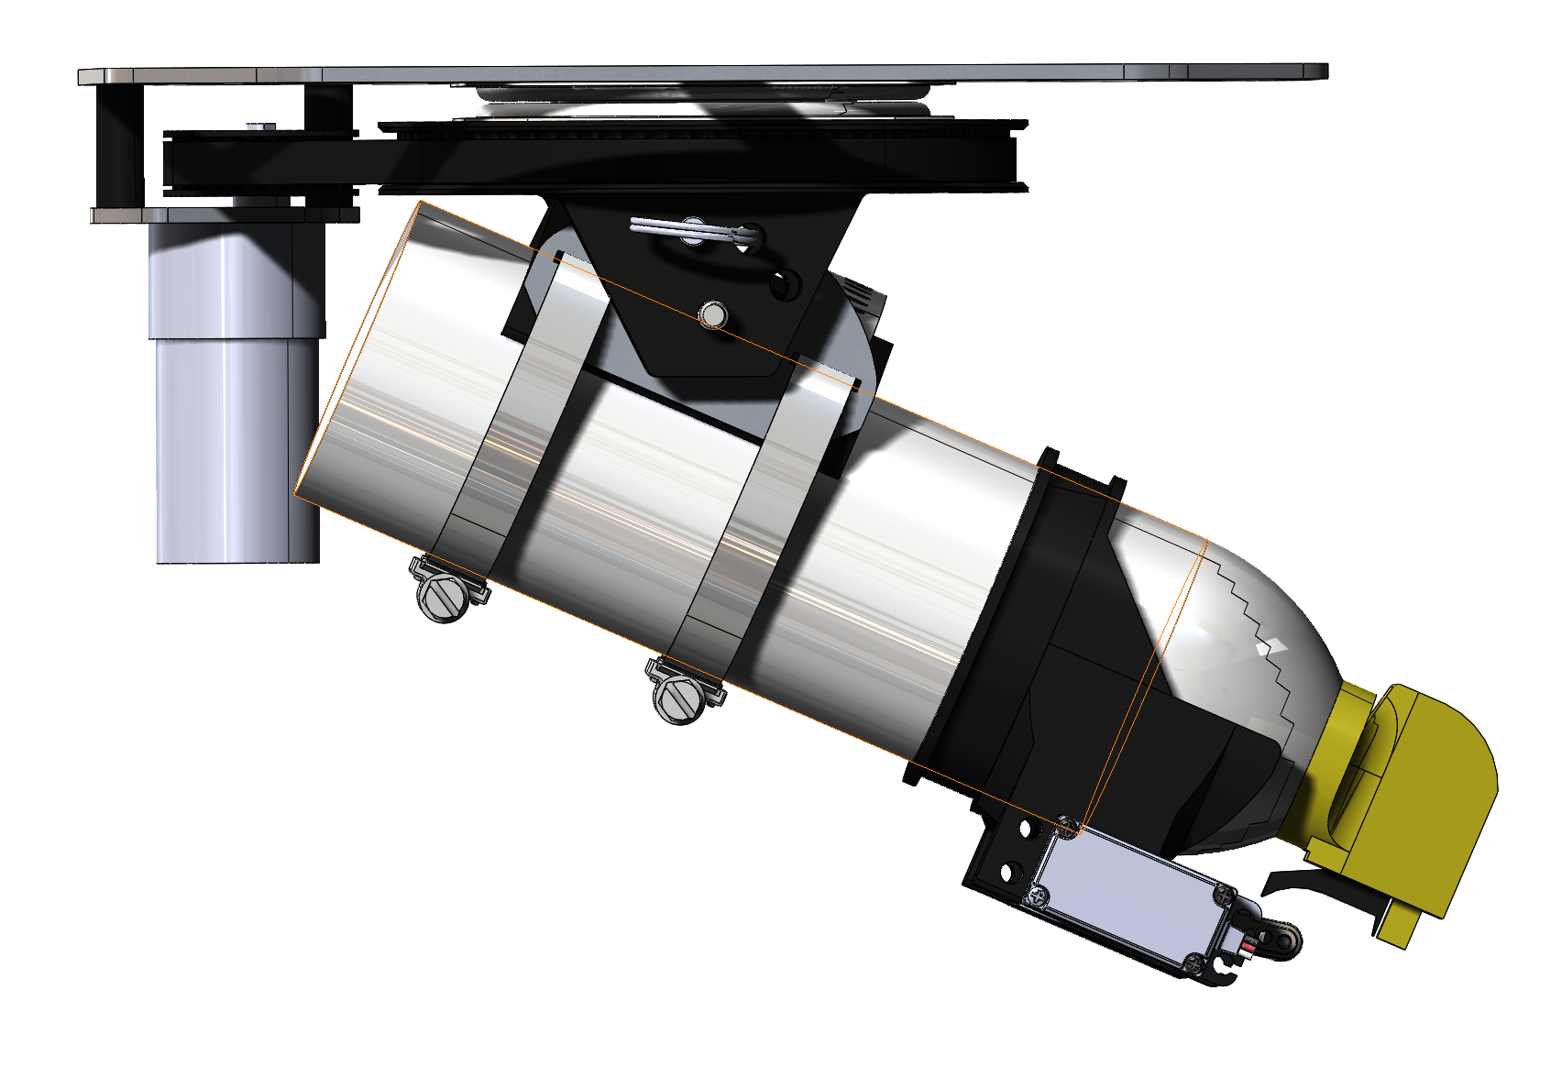
Actuation: Design
All mechanical parts were fully caded in order to achieve dimensional accuracy and a working assembly

Slide 7
Actuation: Results and Issues
Overall motor control worked very well, allowing the turntable to achieve any desired location.
Time based quadrant selection was our final method of rotation control, as we weren’t able to achieve the encoder-based control from this specific motor.
In the future we would probably implement a different motor that allowed encoder control or a separate encoder mounted to the turntable itself.
Servo control worked less effectively than the motor, but we we’re still able to get the servo to rotate and press the trigger on the extinguisher.
Issues with PWM signals and position control were our main issues, preventing us from being able to accurately rotate the servo to the correct position.
Mounting and logistical problems also prevented the design from reaching its maximum mechanical potential.

Slide 8
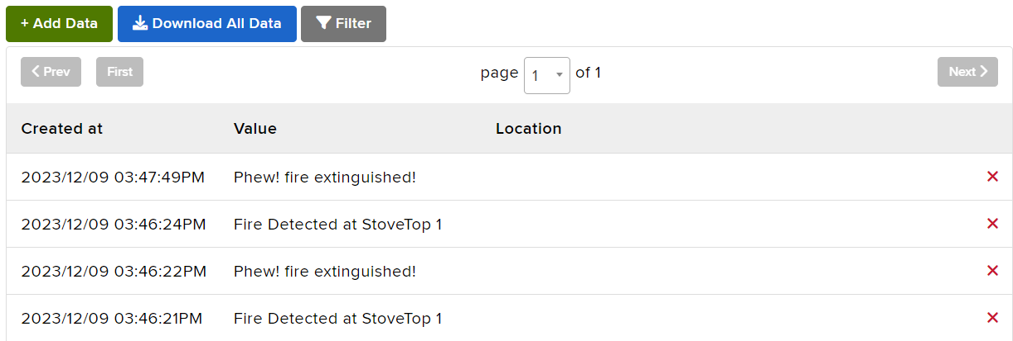
IOT Implementation
Using MQTT and Adafruit.io, we were able to utilize IOT principles and communicate with the computers
Allows for quick and easy communication, transferring info whenever fire is detected by the system
Also alerts users when the fire is put out on the stovetop

Slide 9
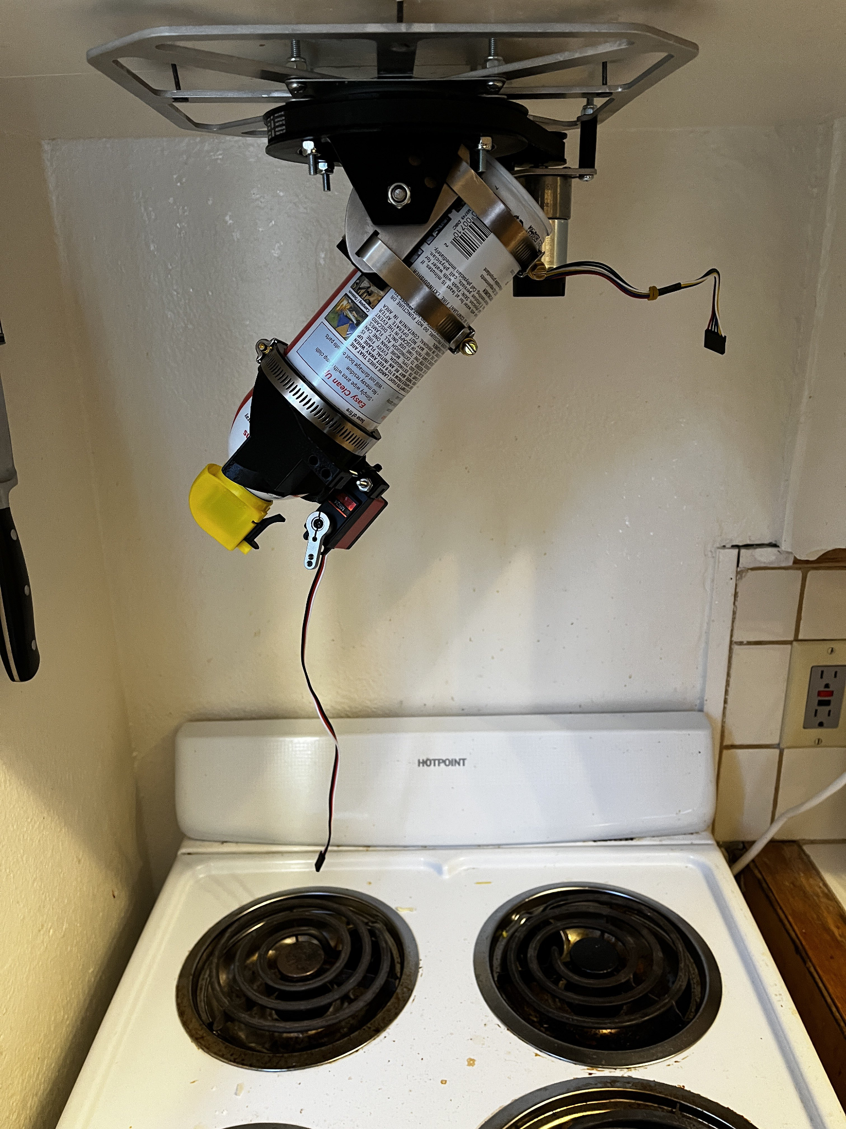
Final Conclusions
Demo: Due to safety and cleanliness concerns, we decided to not actuate the servo resulting in the can spraying
Instead, we will light a flame to determine where the motor has to spin to, as a way of showcasing all minimum aspects of the project

